Slide 1
Weather!
Mom says, “Don’t forget your coat. That cold air mass will getcha!”

Slide 2
Weather: the current condition of the atmosphere
1. Temperature
2. Cloud cover
3. Wind Speed/Direction
4. Humidity
5. Air Pressure
6. Precipitation

Slide 3
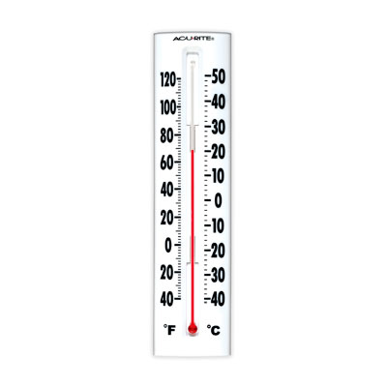
Temperature
How fast the molecules in the air are moving
The hotter it is the more movement of the molecules.
*Measured in degrees Fahrenheit or Celsius*
*Measure with a thermometer

Slide 4
Cloud Cover
LOW
MIDDLE
HIGH
Cumulus (puffy) sometimes fair weather stratus: covers the sky gray
Fog, rainy
Prefix “alto”
Light precipitation
Cirrus
So high,
They are
frozen

Slide 5
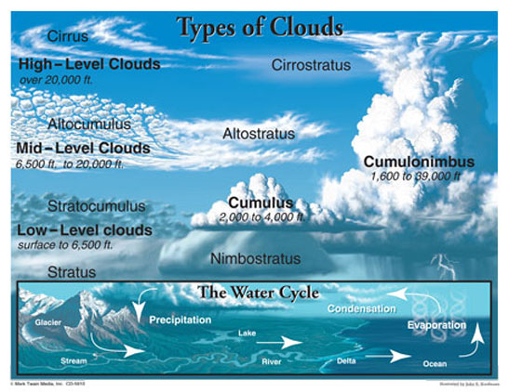

Slide 6
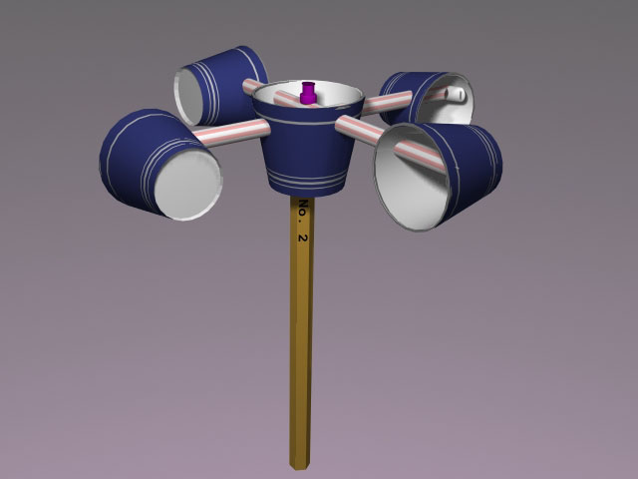
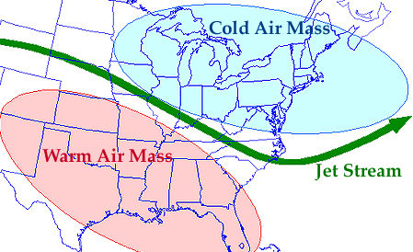
Wind Speed/Direction
Helps us determine what type of weather is coming and when it will arrive
Weather vane = measure wind direction
Anemometer = measure wind speed

Slide 7
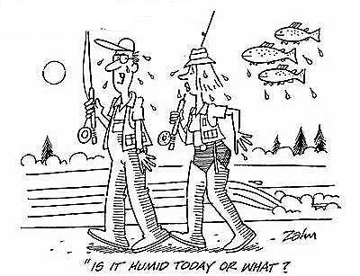
Humidity
Amount of water vapor in the air
More water vapor can be in the air if the temperature is higher.
Measured with a hygrometer in percent (0 to 100).

Slide 8
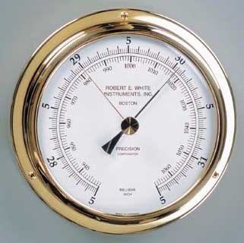
Atmospheric Pressure (Air pressure)
Pressure decreases the higher you go!
Have you ever read on a box of brownie mix, the cooking time may vary for areas of higher altitude? That is because of the atmospheric pressure.
Related to temperature (Heat makes things expand and have less pressure-more space between the molecules.)
BAROMETER

Slide 9
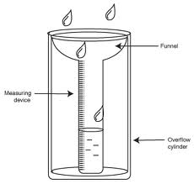
Types of Precipitation
Rain
Freezing Rain
Hail
Sleet
Snow

Slide 10
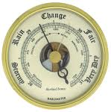
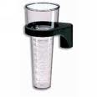
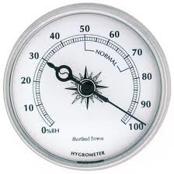
Weather Instruments
Tool & Unit | What it measures | Picture
Thermometer (degrees) | Temperature of the air
Anemometer (mph) | Wind speed
Wind vane (N, S, E, W) | Wind direction
Barometer (pounds/lbs) | Air pressure
Rain gauge (inches) | Amount of precipitation
Hygrometer (0-100%) | Amount of water vapor in the air (percent of relative humidity)

Slide 11
Watch the newscast. Listen to their use of vocabulary words and how it affects their weather prediction. www.wral.com

Slide 12
Which of the following word(s) can be used to describe weather?
Temperature
Cloud cover
Precipitation
All of the above

Slide 13
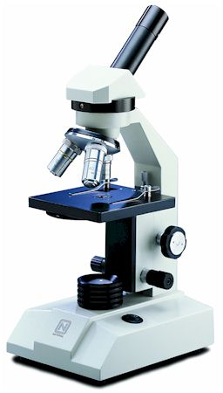
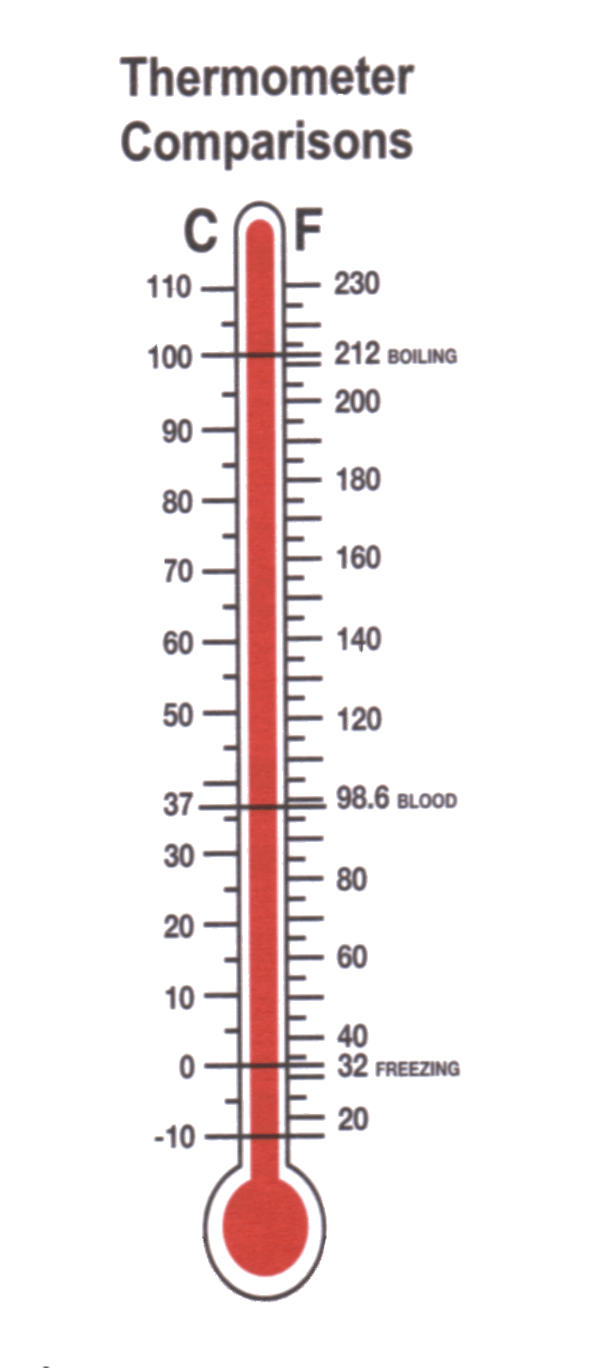
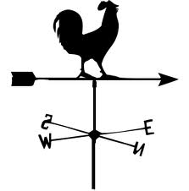
Which of the following do we use to determine wind direction?
A) B)
C) D)

Slide 14
What unit do WE use to measure temperature?
Celsius
Grams
A brief description
Fahrenheit

Slide 15
What is the purpose of a barometer?
To measure atmospheric pressure
To determine cloud cover
To measure the amount of precipitation in the last 24 hours
To determine the type of clouds in the area

Slide 16
What is relationship between temperature and the particles in the air?
A high temperature means the particles are moving quickly.
A high temperature means the particles are moving slowly.

